Slide 1
Silica Safety

Slide 2
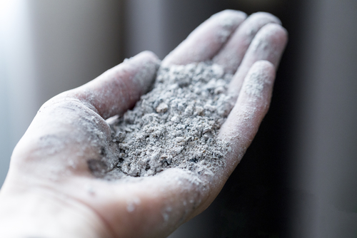
About Silica
Silica is one of the most common minerals on earth, and one of the most common hazards in the workplace.
Silica dust is deadly and is created through processes such as cutting concrete,
dry sweeping, jackhammering, and blasting.

Slide 3
How Silica Can Harm Us
Silica is the second leading cause of occupational lung cancer after asbestos.¹
Every year, 25 Nova Scotians are diagnosed with silica-induced lung cancer.³ With an average annual treatment cost of $70,000 per person, these new cases cost our healthcare system $1,750,000 a year.⁴
Every year, silica-induced lung cancer costs the Canadian healthcare system $562 million.²
These statistics do not include silicosis, COPD, rheumatoid arthritis, or tuberculosis – all illnesses that can occur due to silica exposure.
1 https://www.cancercareontario.ca/en/statistical-reports/burden-occupational-cancer
2 https://www.carexcanada.ca/CAREX_OCRC_Burden_of_Occupational_Cancer_Silica_factsheet.pdf
3 https://www.occupationalcancer.ca/wp-content/uploads/2019/09/OCRC_National-Burden-Report_2019.pdf
4 https://cdn.cancer.ca/-/media/files/cancer-information/resources/publications/2020-canadian-cancer-statistics-special-report/2020-canadian-cancer-statistics-special-report-en.pdf

Slide 4
Identify the Hazards
Check Material Information
Review Safety Data Sheets (SDS):
Look for SDS for any materials you use, as they contain information on composition, hazards, and required personal protective equipment.
Identify silica hazards by checking Safety Data Sheets (SDS) for materials, observing dust generating activities, and recognizing the different names for silica, such as silicon dioxide, quartz, cristobalite, or tridymite.
Look for synonyms:
Silica can be listed under various names. Be aware of terms like "crystalline silica", "silicon dioxide", "quartz", "cristobalite", or "tridymite".
Check product labels:
Basic information regarding hazards and precautions may be available on the product label itself.

Slide 5
Identify the Hazards
Check Material Information
Construction sector:
Activities such as cutting, sawing, grinding, drilling, chipping, and demolition of concrete or masonry structures are primary sources of silica dust.
Tunnelling and excavation:
Earth-moving in areas with high silica content can be hazardous.
Cleaning:
Dry sweeping or using compressed air to clean concrete, rock, or sand dust can re-suspend particles into the air.
Aggregates:
Crushing, loading, hauling, and dumping of rock can generate dust.
Abrasive blasting:
Using sand or other silica-containing abrasives is a high-risk activity.

Slide 6
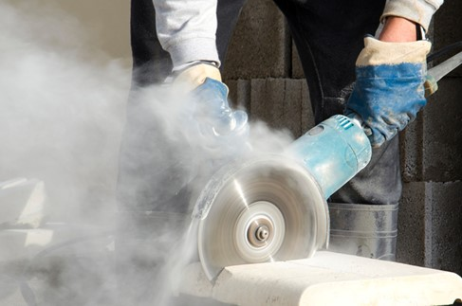
Identify the Hazards
Observe High-Risk Activities
Manufacturing:
Processes involving brick, concrete blocks, pottery, ceramics, and glass can be hazardous.

Slide 7
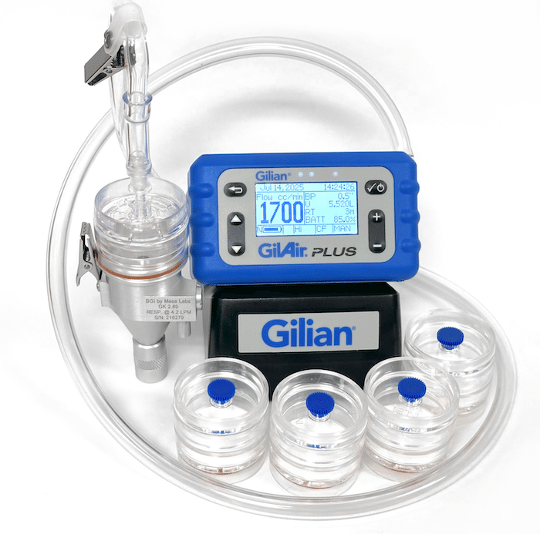
Assessment Methods
Testing:
If you’re unsure whether a material contains silica, have it tested by a qualified facility.
For high-frequency or high-exposure tasks, conduct air quality testing to determine actual exposure levels. Air monitoring is the most reliable way to confirm controls are effective and that the right level of protection is in place.
Test under normal working conditions to ensure accurate results.

Slide 8
Know the Health Effects
Respiratory issues:
Breathing in silica dust can lead to serious and irreversible lung diseases like silicosis, chronic obstructive pulmonary disease (COPD), and lung cancer.
Kidney disease:
Studies show a link between high silica exposure and an increased risk of developing kidney disease.

Slide 9
Hazard Identification Video

Slide 10
Control Strategies
Ensure you properly follow the hierarchy of controls relevant to your jobsite, starting with controls like wet methods, local exhaust ventilation (LEV), and enclosures to capture or suppress dust at the source.
If these are not practical, administrative controls such as safe work procedures and personal protective equipment (PPE) like respirators may become necessary.
Other key strategies include proper housekeeping, and personal hygiene practices such as washing your hands and face before eating and showering after work.

Slide 11
Hierarchy of Controls
Most effective
Reducing risk is not elimination
Engineered controls require competency to safely install
PPE can become a hazard if not used correctly
Least effective

Slide 12
Elimination
Eliminating for most workers is simpler than most people think.
Sufficiently wetting/continuing to wet for long cuts will eliminate the hazard in most scenarios.
This not only protects workers in the immediate area, but the general public and all workers on site as well.

Slide 13
Substitution
Typically, the source of the hazard cannot be substituted when it comes to silica dust, but tools and equipment can be substituted.
Examples of how substitution can help limit exposure levels include:
Moving to a saw with a water tank and hose
Bringing in a coring company with the proper equipment instead of chipping and cutting
Upgrading heavy equipment to units with pressurized cabs

Slide 14
Engineering Controls
Ventilation:
Local or general ventilation to remove the silica from the work area
Dust suppression systems:
Help keep the level of dust workers are exposed to down throughout the production process
Water curtains:
Keeps the dust contained
Positive pressure cabs and buildings:
By keeping windows and doors closed in pressurized cabs and buildings dust does not have the opportunity to get in

Slide 15
Administrative Controls and Safe Work Practices
Administrative controls are the policies and work practices your company puts in place to help limit exposure.
These can include things like:
Silica awareness training for workers
Written exposure control plan
Training on specialized PPE and respirator use
Site rules, such as keeping equipment cab windows closed in dusty areas
Safe Work Procedures
Scheduling changes or work rotation to reduce time spent in high-exposure tasks

Slide 16
Personal protective equipment (PPE)
Respirators:
Use respirators when engineering or administrative controls are not sufficient or practical. Ensure they are properly selected, fitted, and maintained.
Hygiene:
Wash hands and face before eating, and do not eat, drink, or use tobacco products in areas where there is silica dust.

Slide 17
Additional Considerations
Maintenance:
Ensure all engineering controls, such as ventilation and filters, are functioning properly and maintained according to the manufacturer's instructions.
Inspections:
Conduct regular inspections to ensure controls are working properly.
Lifestyle factors:
The most effective way to prevent silica-related illness is to control exposure at work.
Smoking can increase the risk of chronic obstructive lung disease and may worsen the effects of silica exposure.
Quitting smoking can help reduce additional strain on the lungs.

Slide 18
Tools and Resources
Workplace Health and Safety Regulations
Canadian Cancer Society
Nova SAFE
WCB
Lungsquatters.ca
To anonymously report unsafe work, contact the Nova Scotia Department of Labour, Skills and Immigration.
Phone: 1-800-9LABOUR
Email: safetybranch@novascotia.ca

Slide 19

Questions

